Slide 1
CS 202 Automata Theory and Logic
Tutorial-01
The Pumping Lemma for Regular Languages
Date:18/03/2024

Slide 2
The technique for proving nonregularity of some language is provided by a theorem about regular languages called pumping lemma
Pumping lemma states that all regular languages have a special property
If we can show that a language L does not have this property we are guaranteed that L is not regular
All strings in the language can be “pumped" if they are at least as long as a certain value, called the pumping length.
Each such string in the language contains a section that can be repeated any number of times with the resulting string remaining in the language.

Slide 3
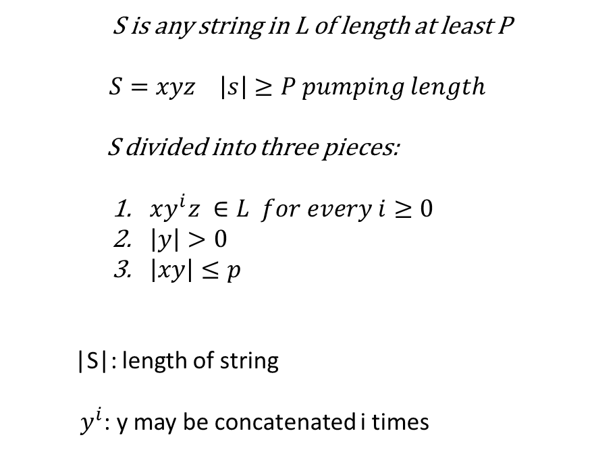
S is any string in L of length at least P
$$S=xyz \left|s\right|≥P pumping length$$
S divided into three pieces:
$xy^{i}z ∈L for every i≥0$
$\left|y\right|>0$
$\left|xy\right|≤p$
|S|: length of string
$y^{i}$: y may be concatenated i times

Slide 4
$$\text{Consider} \text{the} \text{language}\text{ \{}\text{L}\text{ = }0^{n}1^{n} n≥0\text{\}}$$
If we attempt to find a DFA that recognizes language L we discover that such a machine needs to remember how many 0s have been seen so far as it reads the input.
Because the number of 0s isn’t limited, the machine needs to keep track of an unlimited number of possibilities.
This cannot be done with any finite number of states.

Slide 5
$$\text{Consider} \text{the} \text{language}\text{ \{}\text{L}\text{ = }ww^{R} \text{\}}$$
S=0^p1^p0^p
xy<=p
2p<=p
S= 001100
X=001, y=1, z=00
xy^kz
For k= 0 string is 00100 not in L
If y consists only of 1's, pumping it will generate a string that doesn't match L
Let x= 00, y = 11 and z=00
0^p1^2k0^p
xy^2z = 00111100
If y contains both 0's and 1's, pumping it will disturb the balance of 0's and 1's in w, making it fail to be a palindrome.

Slide 6
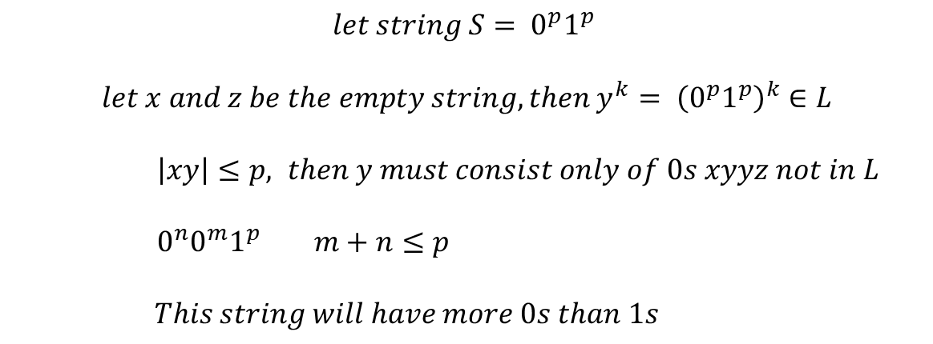
$$\text{Consider} \text{the} \text{language} \text{L}\text{1 =\{}\text{w}\text{ | }\text{w} \text{has} \text{an} \text{equal} \text{number} \text{of}\text{ 0}\text{s} \text{and}\text{ 1}\text{s}\text{\}}$$
$$let string S= 0^{p}1^{p}$$
$$let x and z be the empty string, then y^{k}= {\left(0^{p}1^{p}\right)}^{k}∈L$$
$\left|xy\right|≤p, then y must consist only of 0s xyyz not in L$
$0^{n}0^{m}1^{p} m+n≤p$
$$This string will have more 0s than 1s$$
$$\text{Consider} \text{the} \text{language} \text{L}\text{2 =\{}\text{w}\text{ | }\text{w} \text{has} \text{equal} \text{no} \text{of}\text{ 01 }\text{and}\text{ 10 }\text{substrings}\text{\}}$$

Slide 7
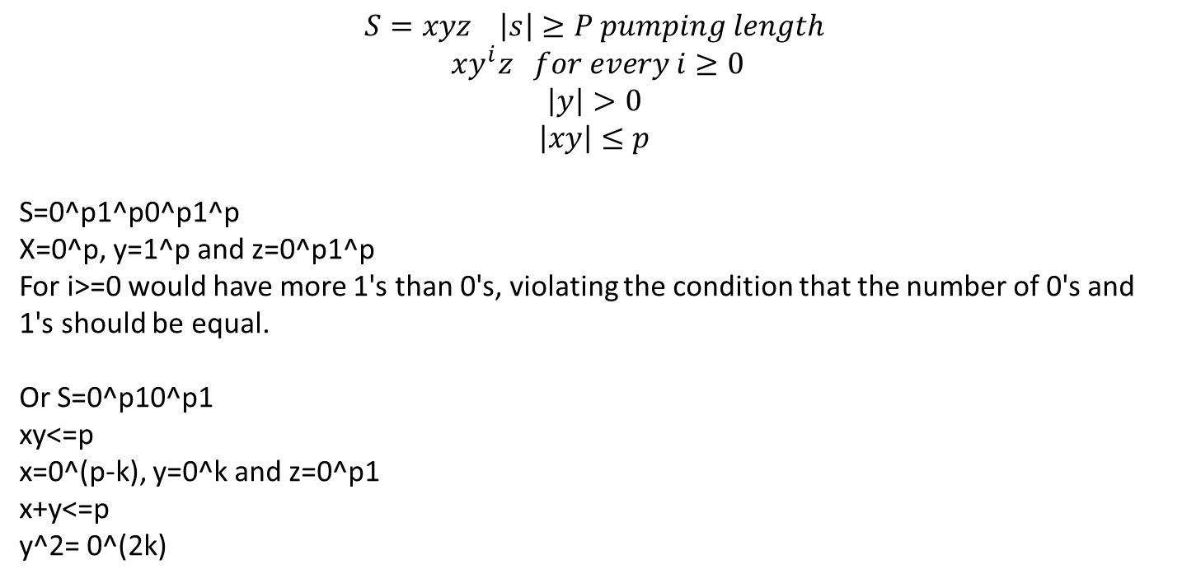
Show that $L=\left\{ww\right|w∈{\{0, 1\}}^{∗}\}$ is nonregular using pumping lemma
$$S=xyz \left|s\right|≥P pumping length$$
$$xy^{i}z for every i≥0$$
$$\left|y\right|>0$$
$$\left|xy\right|≤p$$
S=0^p1^p0^p1^p
X=0^p, y=1^p and z=0^p1^p
For i>=0 would have more 1's than 0's, violating the condition that the number of 0's and 1's should be equal.
Or S=0^p10^p1
xy<=p
x=0^(p-k), y=0^k and z=0^p1
x+y<=p
y^2= 0^(2k)

Slide 8
$$\text{Consider} \text{the} \text{language}\text{ \{}\text{L}\text{ = }{(ab)}^{n}a^{k} | n>k, k≥ \text{\}}$$
$$\text{s} \text{= }{(ab)}^{m+1}a^{m} in L$$
Pick y =a, i=0 (ab)*a*
Pick y= ab, i= 0, (ab)^ma^m which is not in L

Slide 9
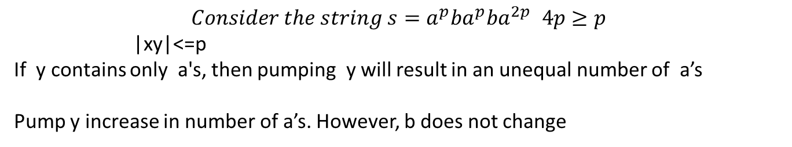
Show that $L=a^{n}ba^{m}ba^{n+m} | n, m≥1\}$ is nonregular using pumping lemma
$$Consider the string s=a^{p}ba^{p}ba^{2p }4p≥p$$
|xy|<=p
If y contains only a's, then pumping y will result in an unequal number of a’s
Pump y increase in number of a’s. However, b does not change

Slide 10
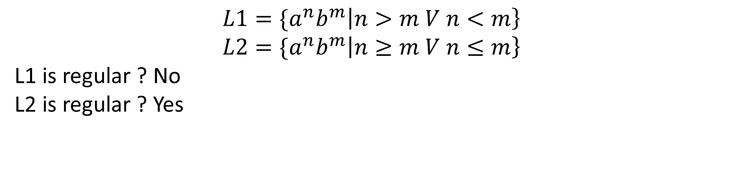
$$L1={\{a}^{n}b^{m}\left|n>m V n<m\right\}$$
$$L2={\{a}^{n}b^{m}\left|n≥m V n≤m\right\}$$
L1 is regular ? No
L2 is regular ? Yes

Slide 11
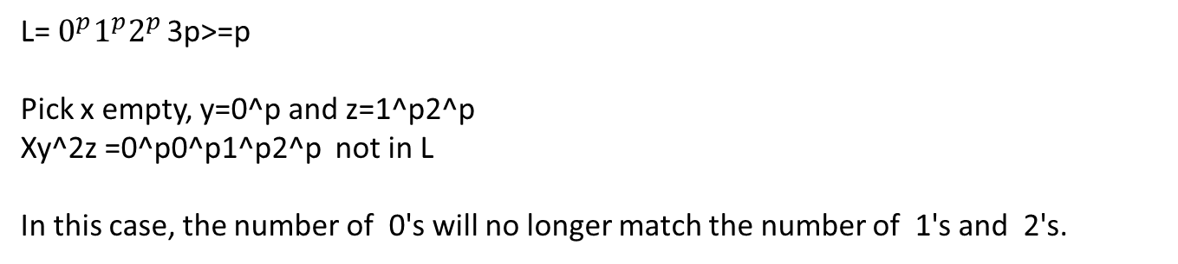
$$\text{Prove} \text{using} \text{the} \text{pumping} \text{lemma} \text{that} \text{the} \text{language} \text{L}\text{=}{ \{0}^{n}1^{n}2^{n }\left| n≥0\right\} is not regular$$
$\text{L}\text{=}{ 0}^{p}1^{p}2^{p }$3p>=p
Pick x empty, y=0^p and z=1^p2^p
Xy^2z =0^p0^p1^p2^p not in L
In this case, the number of 0's will no longer match the number of 1's and 2's.

Slide 12
Find the minimum pumping length for the language 0001*
000 can’t be pumped (because 0000 is not in L)
S=xyz
0001 can be pumped: put x = 000, y = 1, z = rest.
|S|>= 4 can be pumped
So the minimum pumping length is 4

Slide 13
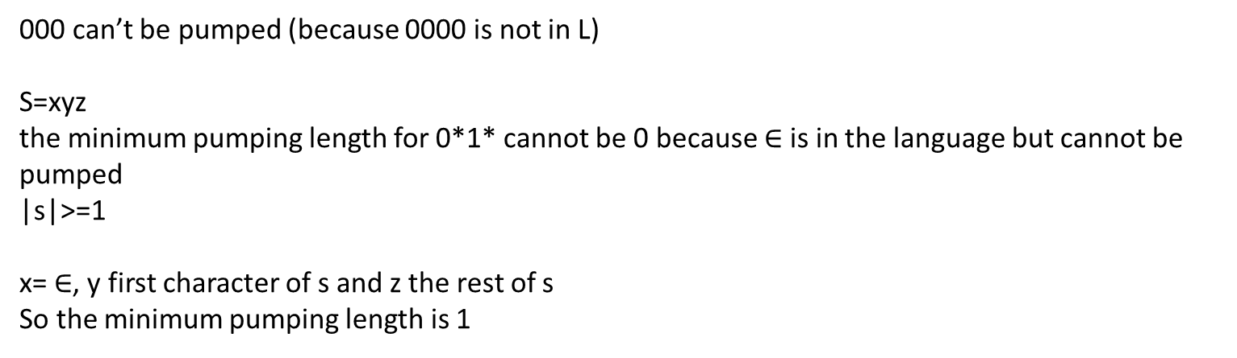
Find the minimum pumping length for the language 0*1*
000 can’t be pumped (because 0000 is not in L)
S=xyz
the minimum pumping length for 0*1* cannot be 0 because $∈$is in the language but cannot be pumped
|s|>=1
x= $∈$, y first character of s and z the rest of s
So the minimum pumping length is 1

Slide 14
Find the minimum pumping length for the language 01*
S=0 in L |s|=1 s cannot be pumped
|s|>=2 can be pumped
For s=xyz, x=0, y=1 and z=rest
Hence, the minimum pumping length for L is 2

Slide 15
Find the minimum pumping length for the following language
$$L=10^{∗}1$$
Minimum pumping length = 3

Slide 16
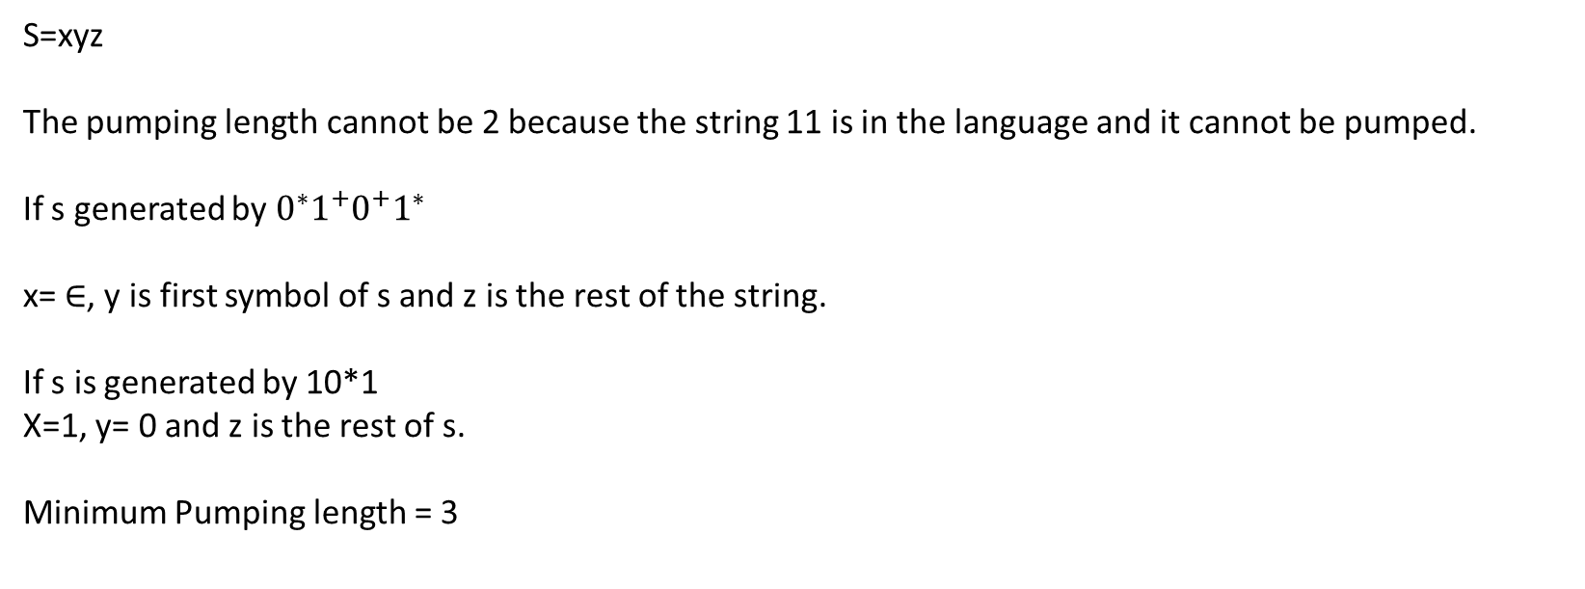
Find the minimum pumping length for the following language:
$L=0^{∗}1^{+}0^{+}1^{∗}∪10^{∗}1$
S=xyz
The pumping length cannot be 2 because the string 11 is in the language and it cannot be pumped.
If s generated by $0^{∗}1^{+}0^{+}1^{∗}$
x= $∈$, y is first symbol of s and z is the rest of the string.
If s is generated by 10*1
X=1, y= 0 and z is the rest of s.
Minimum Pumping length = 3

Slide 17
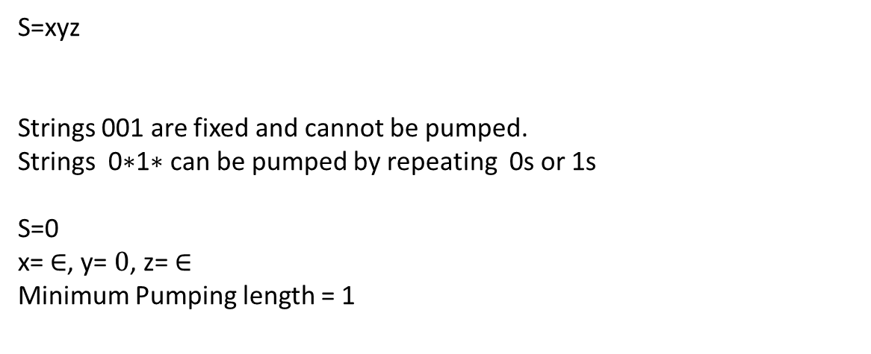
Find the minimum pumping length for the following language: L=001 U 0*1*
S=xyz
Strings 001 are fixed and cannot be pumped.
Strings 0∗1∗ can be pumped by repeating 0s or 1s
S=0
x= $∈$, y= $0$, z= $∈$
Minimum Pumping length = 1

Slide 18
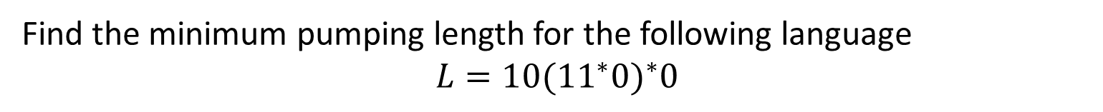
Find the minimum pumping length for the following language
$$L=10{({11}^{∗}0)}^{∗}0$$
S = xyz
S= 10100
x=10, y=10, z=0
y can be 10 (minimum)
we cannot use 3 or less length string from L for pumping
Each string in L starts with "10".
Then, it may have any number of occurrences of "110", followed by "0".
Minimum pumping length for L is 5.

